Slide 1
Adobe Analytics Challenge
Team Nebula

Slide 2
Business Question From the Hilton Team :
The measurement of business vs. leisure travel has always been difficult. The rise of “bleisure” further complicates the matter. What signals in the data provided can help distinguish whether a trip represents business, leisure, or “bileisure” travel? For those purely leisure guests, what information would you use to make recommendations on specific leisure destinations they should considered? Where on the digital properties would you make these recommendations and why?

Slide 3
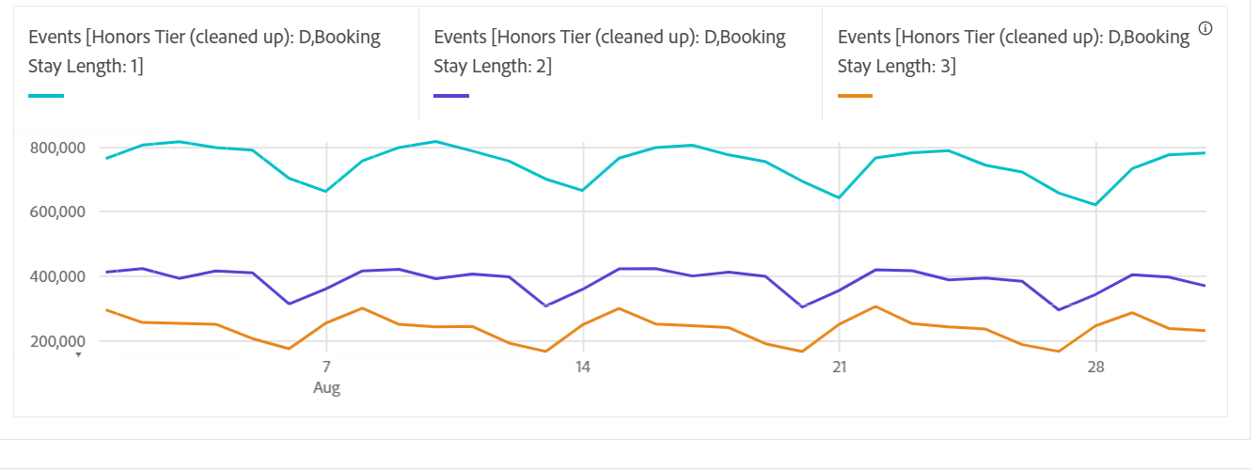
Business
We examined data from the month of August for stays of one to two days at hotels with diamond memberships and came to the conclusion that there was a rise during the week and a decrease during the weekend, indicating that these were typically business trips.
Dip on Sunday
The signals that indicate the trips taken are business trips are
The Diamond Honors Tier
Booking stay Length

Slide 4
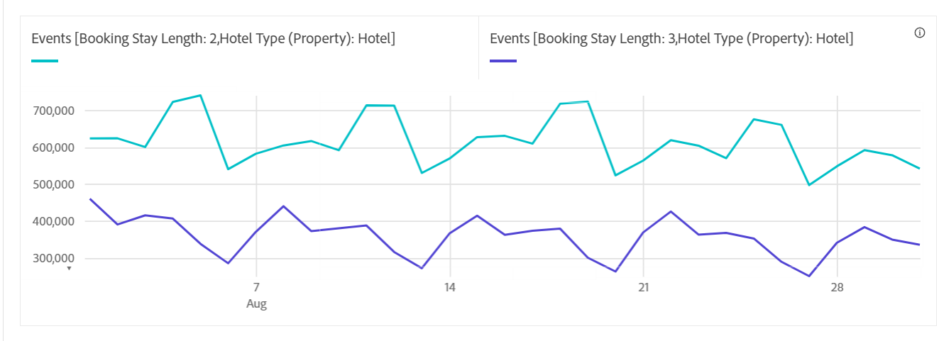
Bleisure
In the month of August, we analyzed hotel occupancy data for two to three days, and we noticed a spike on Fridays, suggesting that some guests may have combined their leisure and business travel.
Rise on Friday
The signals that indicate the trips taken are bleisure trips are
Hotel Type(Property): Hotel
Booking stay Length(2 and 3 Days)

Slide 5
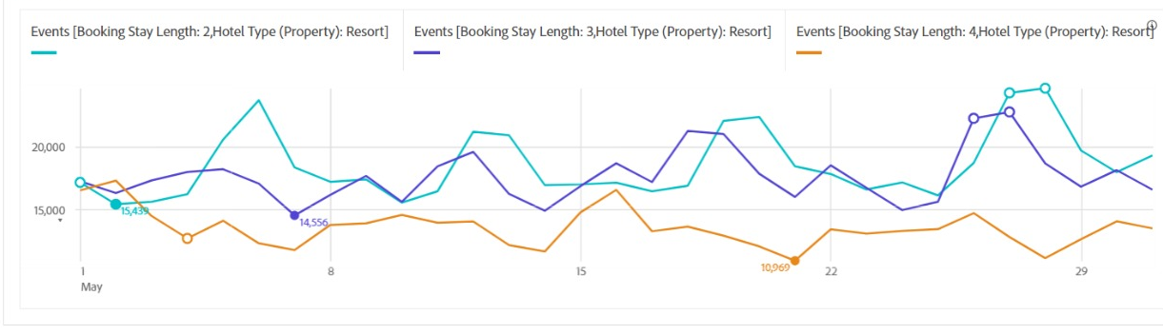
Leisure
We examined a data set of people who spent two to four days in a resort during the month of May, which is typically a vacation time. It is evident that there was no significant variation in the number of people who stayed for these two to four days, indicating that these were leisure visits.
The signals that indicate the trips taken are bleisure trips are
Hotel Type(Property): Resort
Booking stay Length(2 and 3 Days)

Slide 6
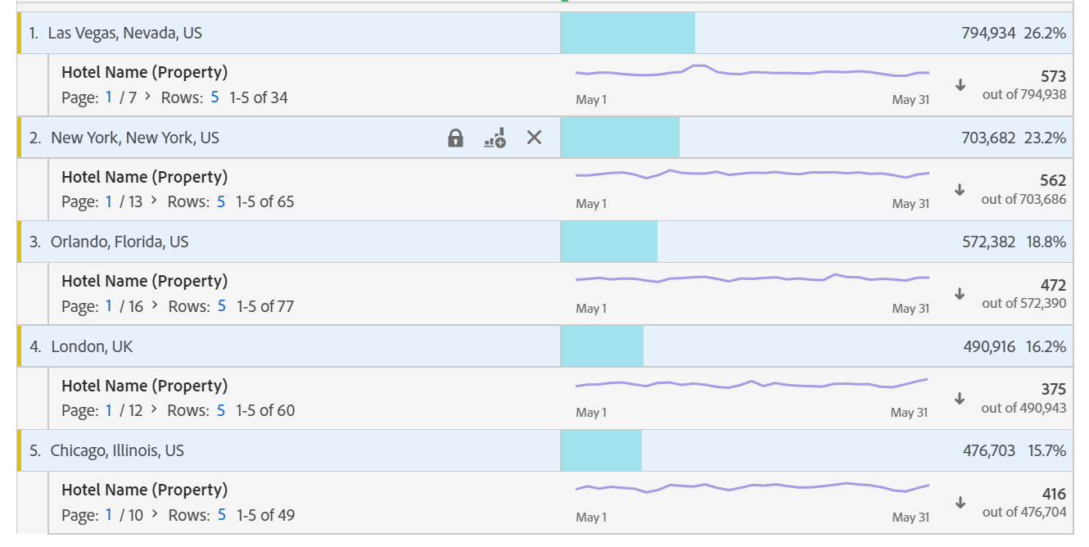
Recommendation for Purely Leisure
Here, we looked at a data set for the month of May, which is typically a vacation month when most individuals plan their leisure trips.
We have provided information on the most popular locations and the hotels there, which can be quite useful in recommending locations to people based on their individual preferences.

Slide 7
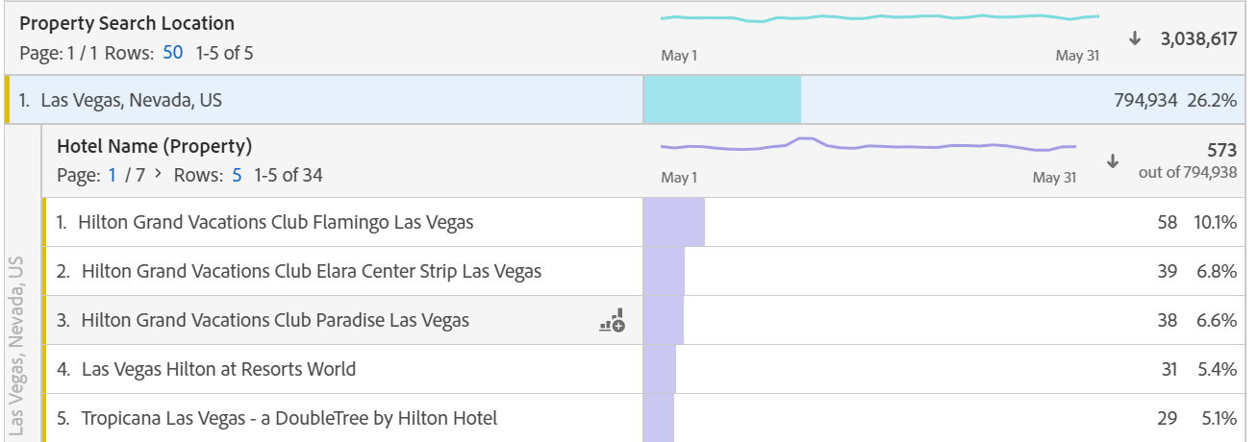
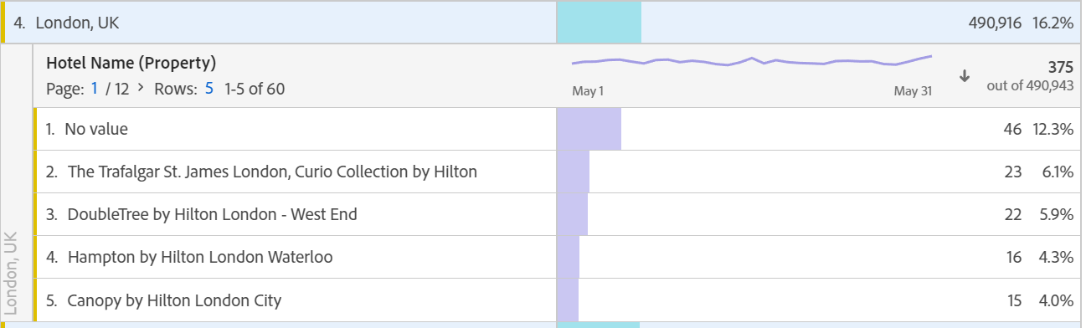
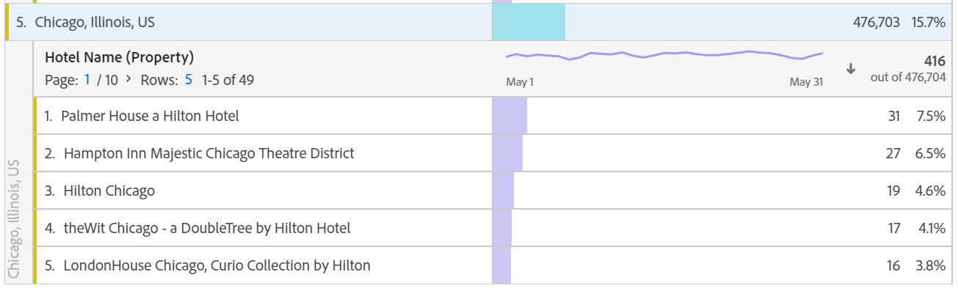
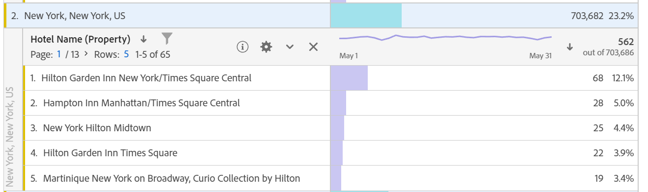
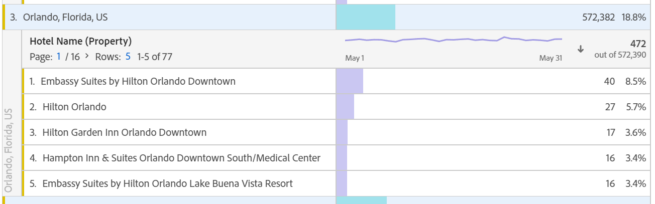

Slide 8
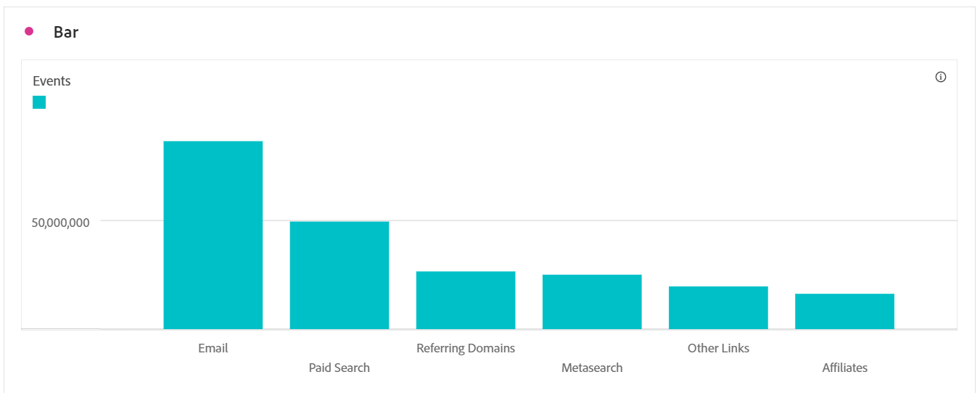
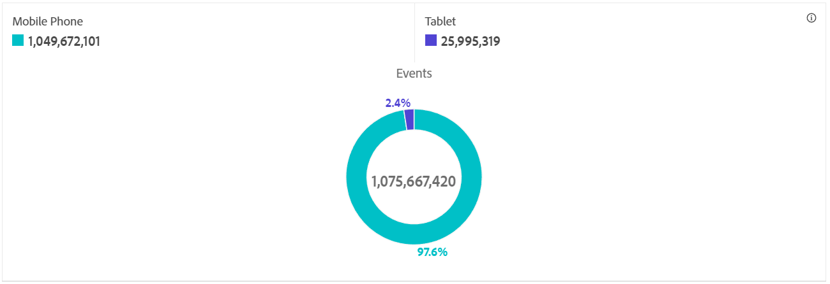
Digital Properties for Recommendations
The donut chart, which shows the majority of the devices that customers use to interact with the Hilton interface, shows that mobile phones and tablets are the two devices that users use the most.
The bar graph that follows shows preferred marketing channels.
First, email; the remaining information is displayed in a bar graph, so that a recommendation can be made accordingly.

Slide 9
Thank You

